Slide 1


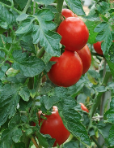



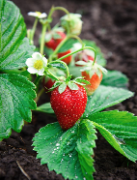
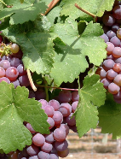
The Plant Doctor: Monitoring Plant Health with Machine Learning
Patra Holmes
San Francisco State University
July 30, 2021

Slide 2
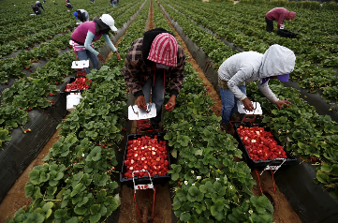
The Plant Doctor Project
Assist agriculture by automating assessment of:
Soil composition
Plant health
Companion planting
Why?
Agriculture a large part of CA economy
~ $50B annually
Increasing number of community gardens in urban areas
Can provide a quick scanning tool to
Save time
Store data for long-term analysis

Slide 3
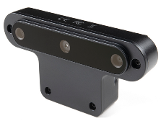
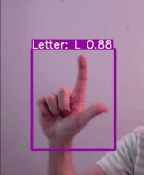
Hand-held OAK-D AI Device
RGB camera
Central 12K RGB color camera
Two monochromatic stereo cameras
Distance of objects
Built-in AI capabilities with a Myriad X chip
Object detection
Classification
Segmentation
Tracking
Capable of running multiple Convolutional Neural Networks (CNNs) simultaneously
Affordable - $200
Stereo
cameras
OAK-D device
Inference during live stream

Slide 4

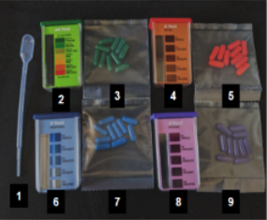
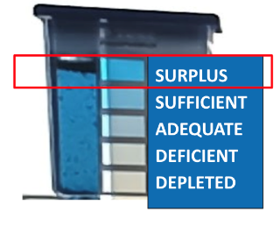
Components of the Project
Environmental Science
Soil composition analysis using a colorimetric assay
Phosphorus soil test kit
Anneke Moller, Lorena Benitez Rivera, & Daisy Estrada Reynoso

Slide 5
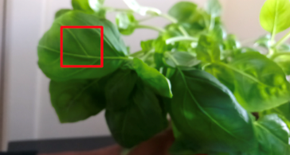
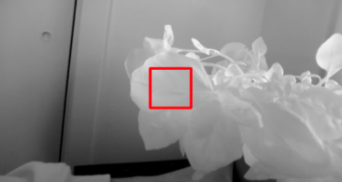
Components of the Project
Environmental Science
Soil composition analysis using a colorimetric assay
Enhanced Spectral Imaging
Monitors light reflected by the plant outside of the visible spectrum
RBG color camera
Infrared camera
Madu Nzerem & Faye Orcales

Slide 6
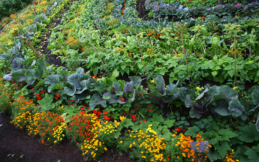
Components of the Project
Environmental Science
Soil composition analysis using a colorimetric assay
Enhanced Spectral Imaging
Monitors light reflected by the plant outside of the visible spectrum
Companion Planting
Different crops in proximity can benefit each other
Berenice Chavez & Maxamillian Schneider

Slide 7
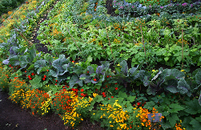
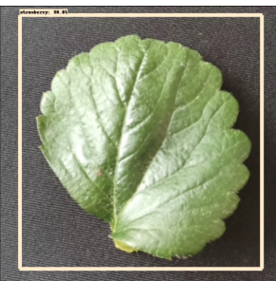
Components of the Project
Environmental Science
Soil composition analysis using a colorimetric assay
Enhanced Spectral Imaging
Monitors light reflected by the plant outside of the visible spectrum
Companion Planting
Promotes beneficial companion planting
Plant Identification
To be used by neighbor analysis
Patra Holmes, Johana Aleman, & Amisha Dhawan

Slide 8
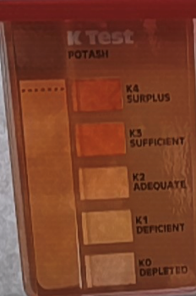
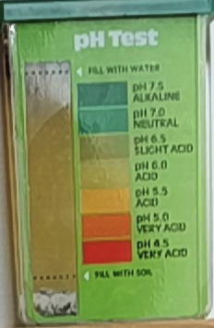
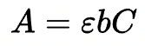
1) Environmental Science
Automated readings of test kits: reliable and archivable
Nitrogen – chlorophyll
Potassium – roots
Phosphorus – ATP
pH – nutrient solubility
Concentrations determined by:
Saturation – depth of color (3 nutrients)
Beer-Lambert Law
Hue – perceived color (pH)
Potassium test kit
pH test kit

Slide 9

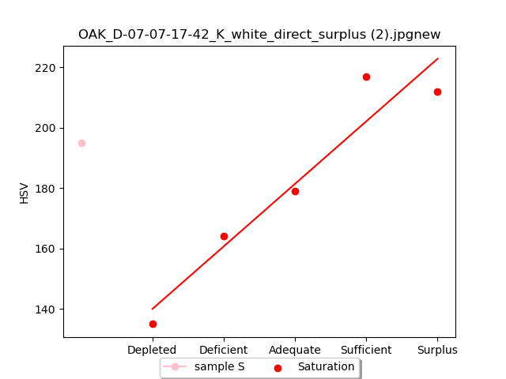
1) Environmental Science
OAK-D K Sample - Saturation
sample
Potassium sample with corresponding plot on a standard curve

Slide 10

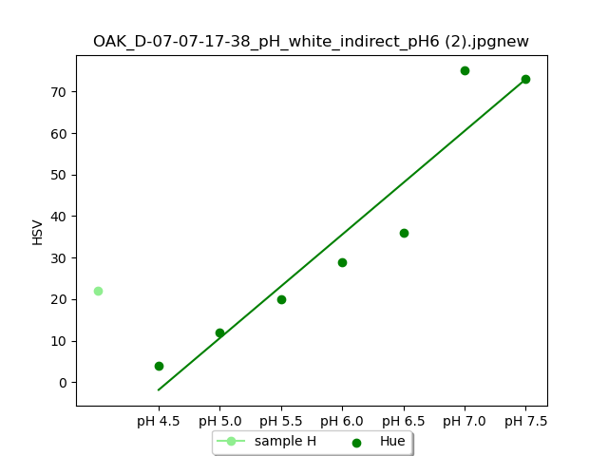
1) Environmental Science
OAK-D pH Sample - Hue
sample
pH sample with corresponding plot on a standard curve

Slide 11
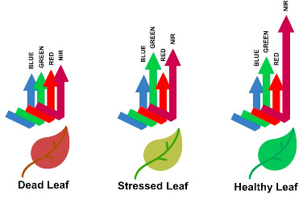
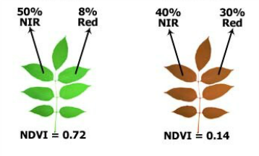

OK – Green leaves are an indication of chlorophyll
BETTER – Normalized Difference Vegetation Index (NDVI)
2) Spectral Imaging
Healthier plant Higher NDVI

Slide 12
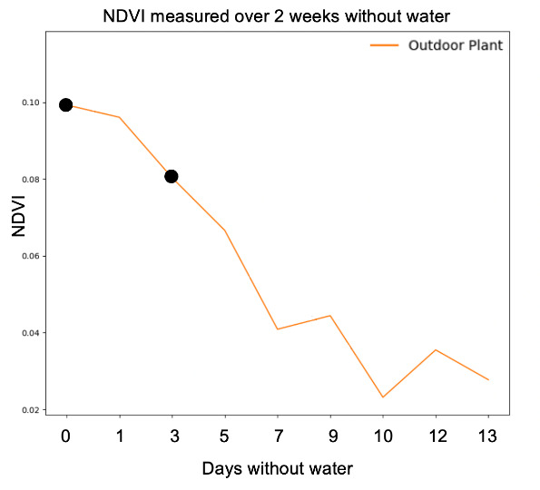
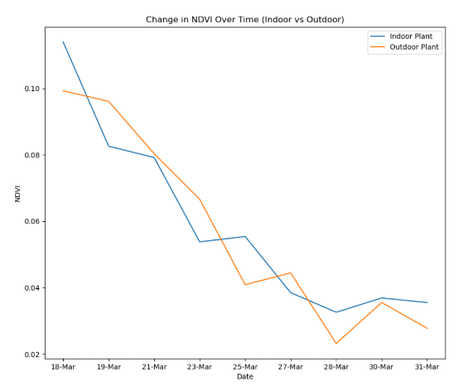

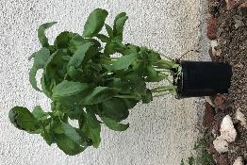
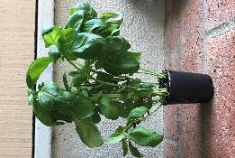



Spectral Imaging: Tracking Chlorophyll Content
NDVI measured over 2 weeks without water
NDVI
0 1 3 5 7 9 10 12 13
Day 0
Day 3
Days without water

Slide 13
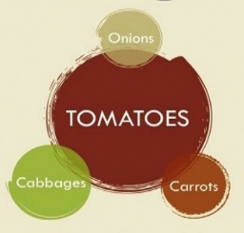
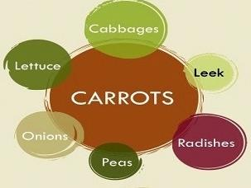
3) Companion Planting
Evaluate existing plants and suggest neighboring plants
Companion planting promotes:
Pollination
Crop productivity
Pest control
Less pesticides
Maximizes the potential of urban gardens
https://diygabl.tumblr.com/post/141353640807/companion-planting-guide

Slide 14
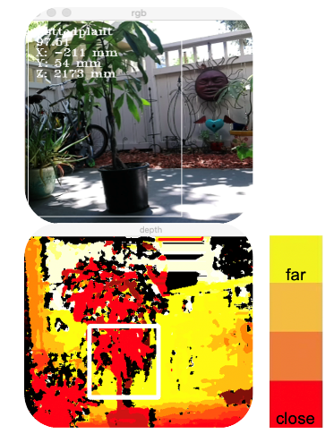
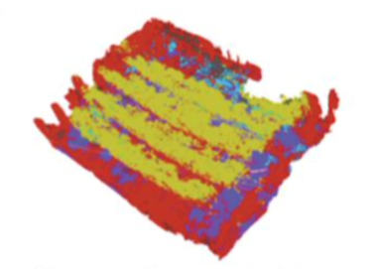


3D Mapping
3D map with plant labels
Simultaneous identification &
depth information obtained by device

Slide 15
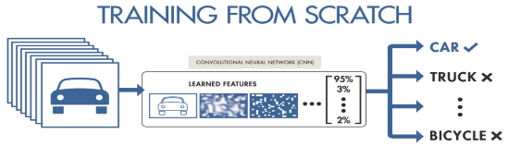
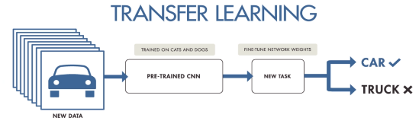
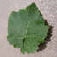
4) Plant Identification
What is Machine Learning?
Convolutional Neural Network (CNN) model
Pre-trained models already trained on thousands of images
Can already extract features
Train model on your own data
GRAPE
STRAWBERRY
https://purnasaigudikandula.medium.com/deep-view-on-transfer-learning-with-iamge-classification-pytorch-5cf963939575

Slide 16
Types of Convolutional Neural Networks
Conventional CNNs
Single-Shot Detector (SSD) CNNs

Slide 17
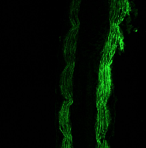
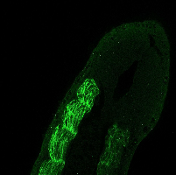

Types of Convolutional Neural Networks
Conventional CNNs
Very large and complex
For classification on computers
Biological image analysis
Medical image analysis
Single-Shot Detector (SSD) CNNs
Example of biological use:
Normal tadpole embryo Mutant tadpole embryo
Tadpole data: Google Colab CSUPERB_Transfer_Learning_Demo

Slide 18
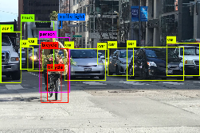
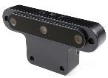
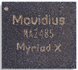
Types of Convolutional Neural Networks
Conventional CNNs
Very large and complex
For classification on computers
Biological image analysis
Medical image analysis
Single-Shot Detector (SSD) CNNs
30x smaller
10x faster
For object detection/classification on small devices
Example of biological use:
Dash cam detection with bounding boxes
MobileNetv2-SSD for our purposes
Normal tadpole embryo Mutant tadpole embryo
Tadpole data: Google Colab CSUPERB_Transfer_Learning_Demo
Myriad computer chip inside OAK-D runs SSD

Slide 19
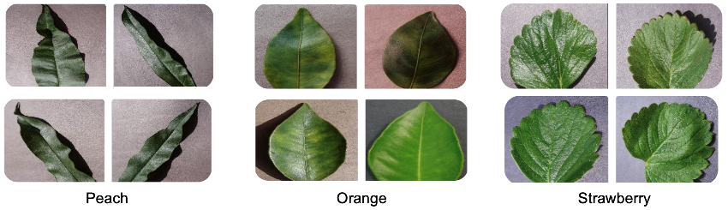
Curating Leaf Dataset for Plant Identification
Training VGG16 and MobileNetv2-SSD model on leaf image dataset :
8 classes: Orange, Peach, Bell Pepper, Strawberry, Grape, Apple, Tomato, Raspberry
VGG-16: 300 images per class (color only)
MobileNetv2-SSD: 940 images per class: color, -25% brightness, rotated/inverted, B&W
Bounding boxes placed around leaves
https://www.kaggle.com/abdallahalidev/plantvillage-dataset

Slide 20
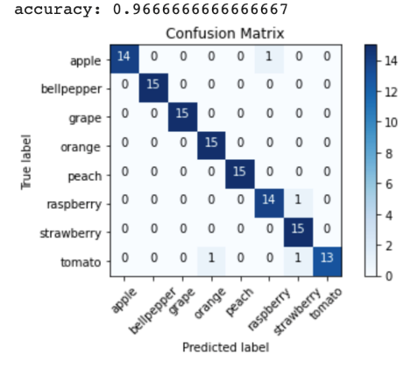
Plant Identification with VGG16 CNN
Training and Testing the model:
Trained on the Kaggle dataset
300 color per class
Tested with images from Kaggle
15 per class
Accuracy of 97%
Only 4 out of 120 misclassified

Slide 21
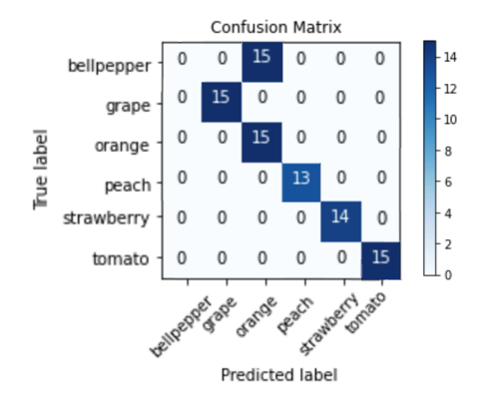
Plant Identification with MobileNetv2-SSD CNN
Training and Testing the model:
Trained on the Kaggle dataset
300 color
245 -25% brightness
245 rotated or inverted
150 B&W
Tested with images from home garden with OAK-D
Only 6 available to us
Further data curation can increase:
Classification accuracy
Bell pepper misclassified
Detection ability
Two peach leaves undetected

Slide 22
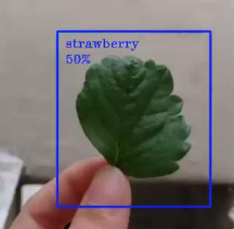
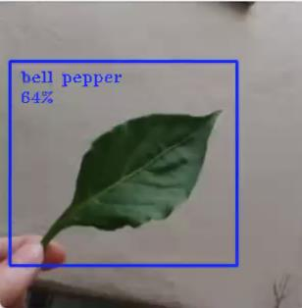
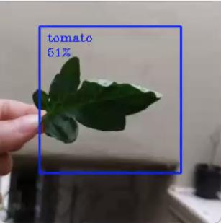
OAK-D in Action
Classification
% confidence in model’s prediction
Accurately performing leaf detection
Fine-tuning model can increase % confidence

Slide 23
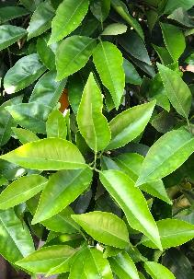
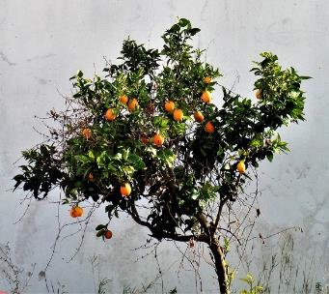
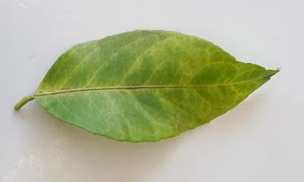
Plant ID for Both Close-up and Full Plant
Current stage
Future goals

Slide 24
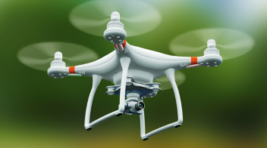
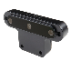
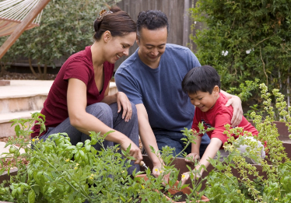
Can Crop Health Be Improved?
Must consider:
Overall health
Soil composition
Pest control
Pollinator population
The Plant Doctor App:
Reduce time spent on monitoring crops
Store data for long-term analysis
Help increase yield and quality

Slide 25







Acknowledgements
NIH MARC: T34-GM008574
NSF STC CCC: DBI-1548297
SFSU & SEO
PINC
BIOL/CHEM 667 Optical Engineering Instructors – Nicole Adelstein, Mark Chan, Raymond Esquerra, & Thomas Zimmerman
OpenCV AI Competition 2021 – Provided access to Microsoft Azure, Intel DevCloud’s openVINO, SuperAnnotate, and OAK-D devices
Roboflow – Object detection training tutorial and data storage

